Slide 1


Audacity and Openshot
Open-source digital audio editor and recording application software
OpenShot Video Editor is a free and open-source video editor

Slide 2
Audacity
Audacity is a free and open-source digital audio editor and recording application software, available for Windows, macOS/OS X and Unix-likeoperating systems.
Audacity was started in the fall of 1999 by Dominic Mazzoni and Roger Dannenberg at Carnegie Mellon University and was released on May 28, 2000 as version 0.8.
As of October 10, 2011, it was the 11th most popular download from SourceForge, with 76.5 million downloads. Audacity won the SourceForge 2007 and 2009 Community Choice Award for Best Project for Multimedia.
In March 2015 hosting was moved to FossHub and by March, 2019 it had exceeded 70.6 million downloads there.

Slide 3
Features and Functions
Recording
Audacity can record live audio through a microphone or mixer, or digitize recordings from other media.
Export / Import
Import, edit, and combine sound files. Export your recordings in many different file formats, including multiple files at once.
Sound Quality
Supports 16-bit, 24-bit and 32-bit. Sample rates and formats are converted using high-quality resampling and dithering.
Plug-ins
Support for LADSPA, LV2, Nyquist, VST and Audio Unit effect plug-ins. Effects can be easily modified in a text editor – or you can even write your own plug-in.

Slide 4
Editing
Easy editing with Cut, Copy, Paste and Delete. Also unlimited sequential Undo (and Redo) in the session to go back any number of steps.
Effects
Real-time preview of LADSPA, LV2, VST and Audio Unit (macOS) effects. Plug-in Manager handles plug-in installation and addition/removal of effects and generators from the menus.
Accessibility
Tracks and selections can be fully manipulated using the keyboard. Large range of keyboard shortcuts.
Analysis
Spectrogram view mode for visualizing and selecting frequencies. Plot Spectrum window for detailed frequency analysis.

Slide 5
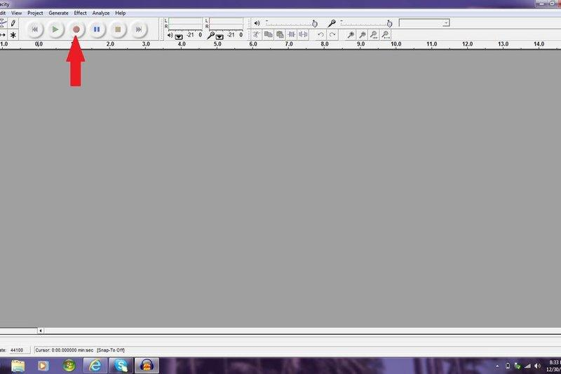
Basic recording and Editing
Step 1: Recording and Playback
The first thing I will show you is how to record and playback sounds in Audacity. These are the most basic functions of Audacity.
To record just click the red dot in the upper left corner.
To stop recording click the orange square in the
upper left corner.
To playback the sounds you have recorded or imported
click the green triangle in the upper left corner.

Slide 6
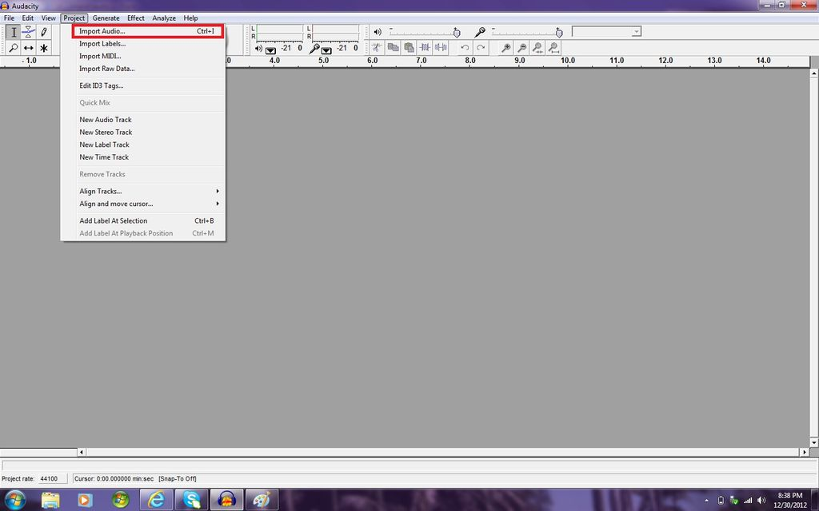
Step 2: Importing Audio Tracks
To import audio tracks click on the project tab in the upper left corner of the screen.
Then click on import audio.
Select the file you want to open.
Click open.

Slide 7
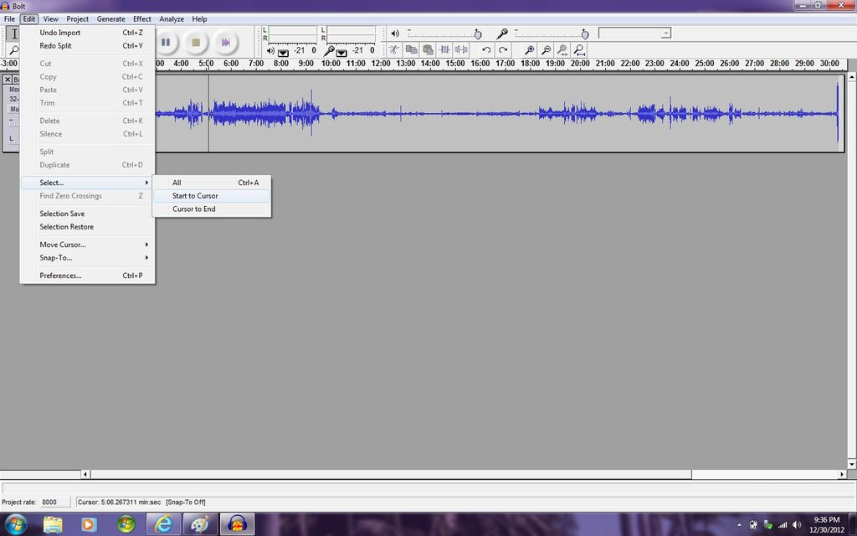
Step 3: Selecting Audio
To select all of the audio click on the edit tab,
then click on select, then click on select all,
or press Ctrl A on the keyboard.
To select from your cursor to the beginning or end
click on the edit tab.
Then click on select.
Then click on "cursor to end" or "start to cursor"

Slide 8
Step 4: Editing the Tempo of the Audio
To edit the tempo of the audio select the section of audio you want to edit.
Then click on the effect tab.
Then click on Change Tempo (DO NOT CLICK ON CHANGE SPEED, this will change the speed AND pitch of the audio)
Click and drag the meter to change the tempo (you will have to experiment to learn what "percent change" you need to get the correct tempo)
Click preview to here a sample of the audio you edited
When you like the tempo of the audio click on "OK"

Slide 9
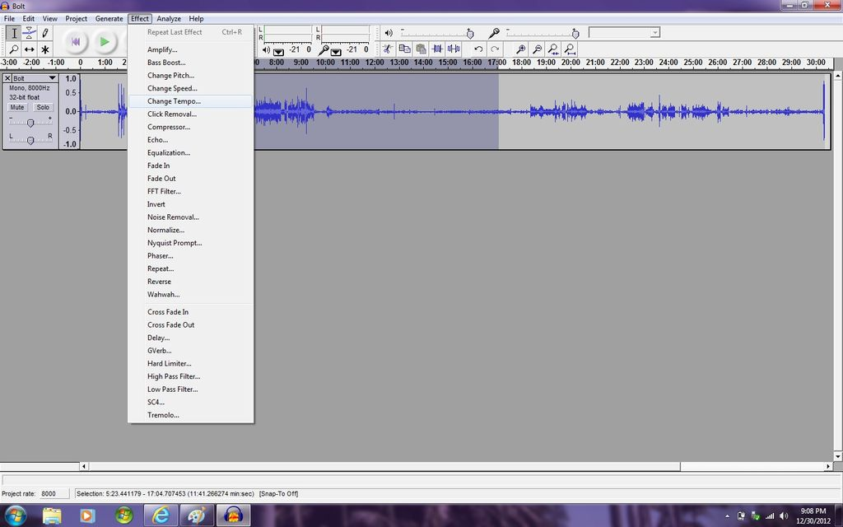
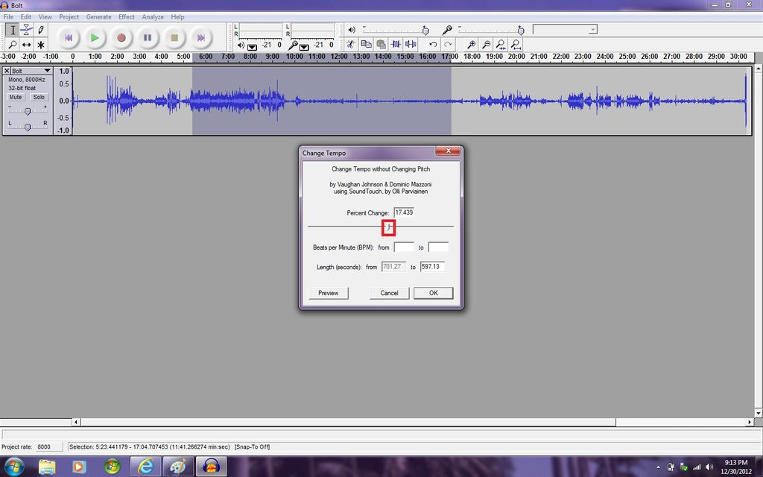
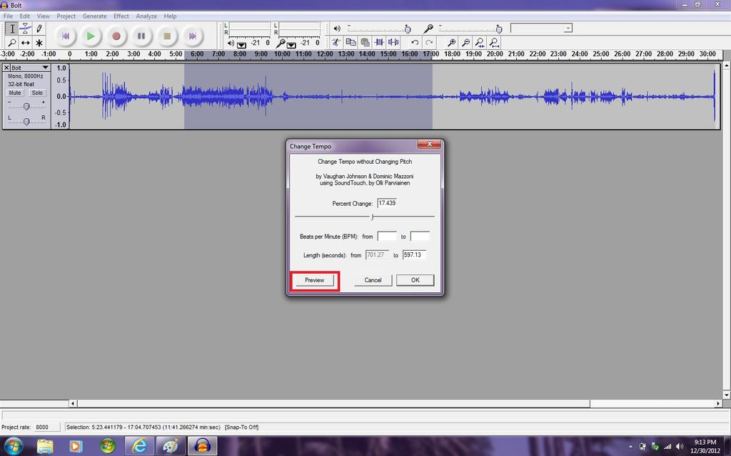

Slide 10
Step 5: Editing the Pitch of the Audio
-To edit the pitch of the audio select the section of audio you want to edit.
-Then click on the effect tab.
-Then click on Change Pitch
-Click and drag the meter to change the pitch (you will have to experiment to learn what "percent change" you need to get the correct pitch)
-Click preview to here a sample of the audio you edited
-When you like the pitch of the audio click on "OK"

Slide 11
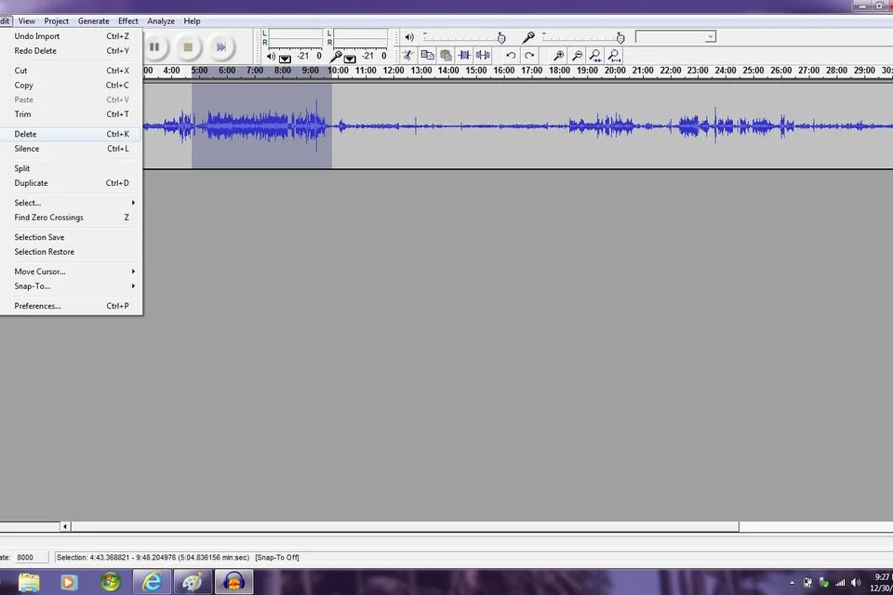
Step 6: Deleting Audio
To delete audio select the section of audio you want to delete and click on the edit tab then delete, or press Ctrl-K, or press the delete key on the keyboard, or press the backspace key on the keyboard

Slide 12
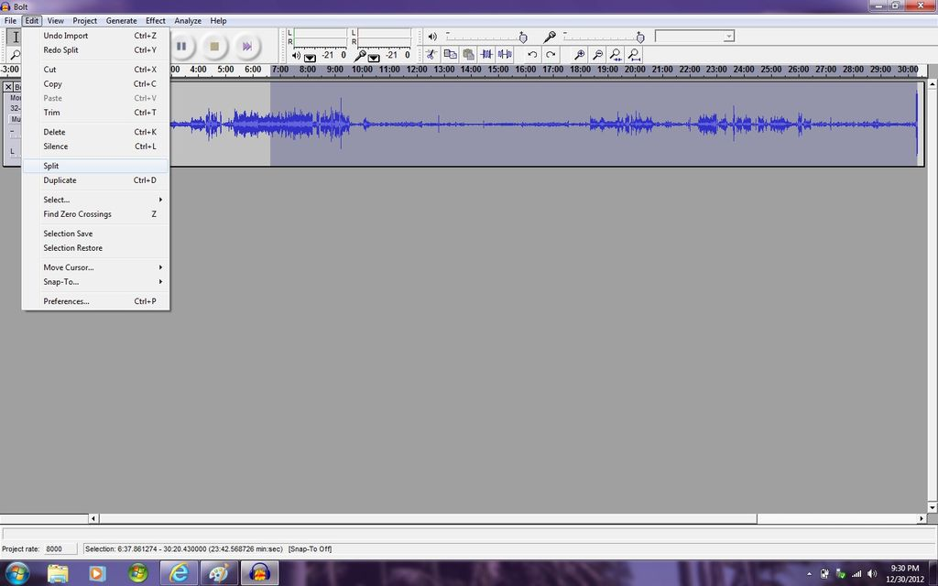
Step 7: Splitting Audio Tracks
To split audio tracks you have to select the second have of what you want to split.
Then you click on the edit tab.
Then click on split.

Slide 13
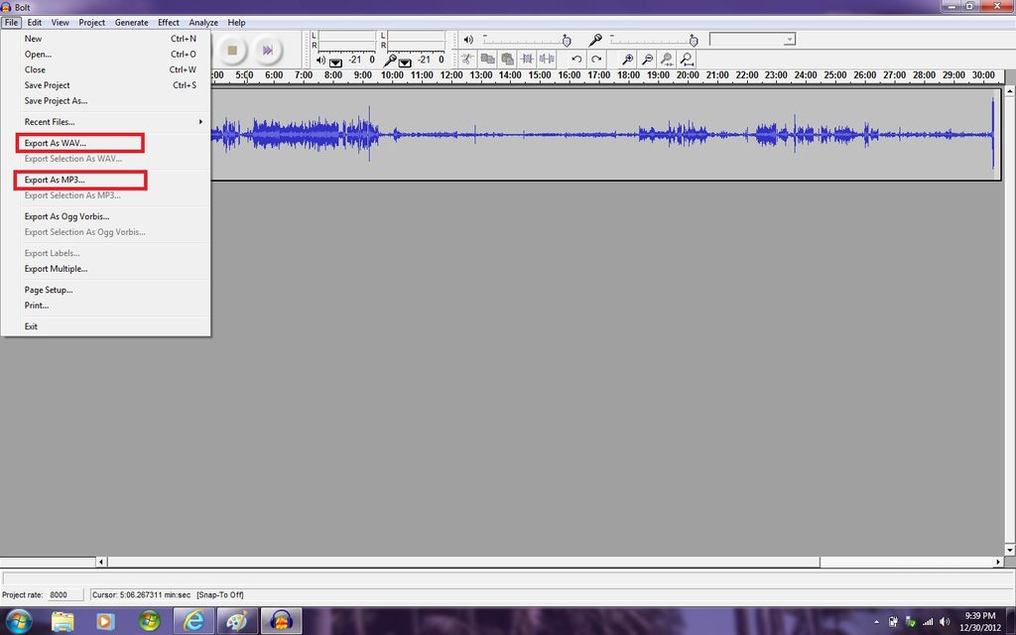
Step 8: Exporting Audio
To export the audio click on the File tab.
Then click on "Export as WAV" or "Export as MP3"
The name the file and click save.

Slide 14
Openshot
OpenShot Video Editor is a free and open-source video editor for FreeBSD, Linux, macOS, and Windows. The project was started in August 2008 by Jonathan Thomas, with the objective of providing a stable, free, and friendly to use video editor.
Open Shot's core video editing functionality is implemented in a C++ library, libopenshot. OpenShot uses the Qt toolkit and offers a Python API.
OpenShot supports commonly used codecs that are supported by FFmpeg, including WebM (VP9), AVCHD (libx264), HEVC (libx265), and audio codecs such as mp3 (libmp3lame) and aac (libfaac).
The program can render MPEG4, ogv, Blu-ray, and DVD video, and Full HD videos for uploading to Internet video web sites

Slide 15
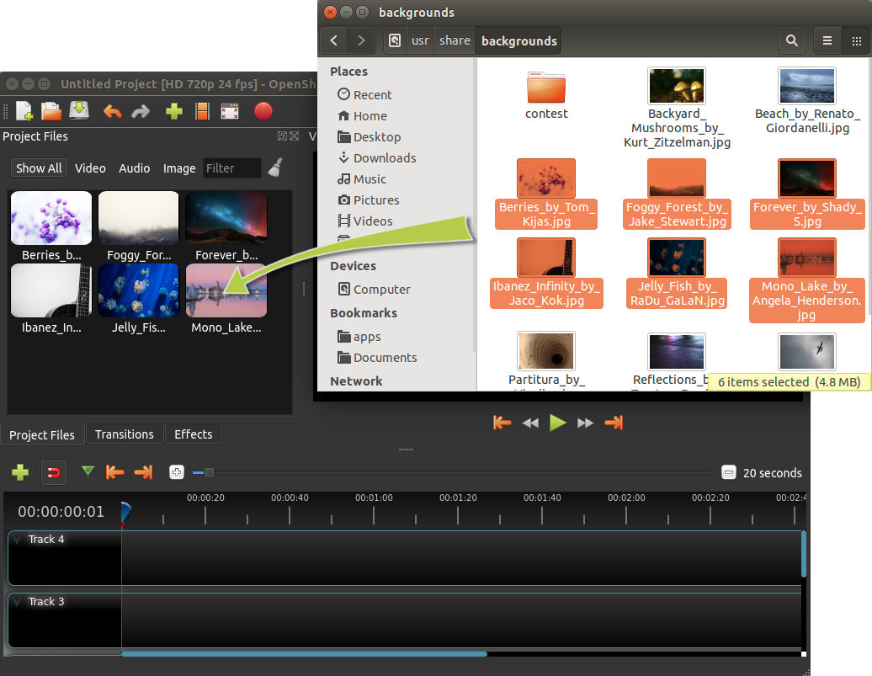
Quick Tutorial
Step 1 – Import Photos & Music
Before we can begin making a video, we need to import files into OpenShot. Drag and drop a few images (*.JPG, *.PNG, etc...) and a music file (most formats will work) from your Desktop to OpenShot. Be sure to drop the files where the arrow in the illustration is pointing to.

Slide 16
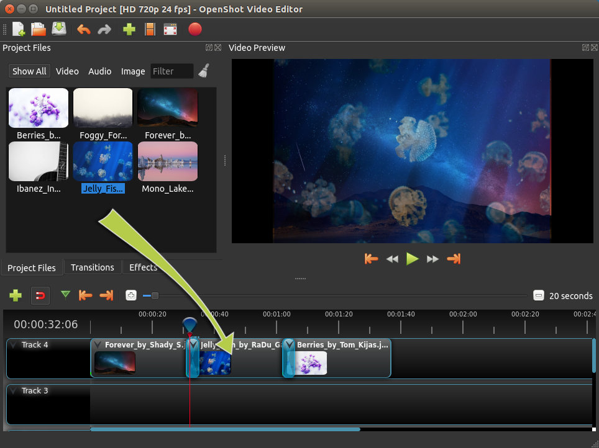
Step 2 – Arrange Photos on Timeline
Next, drag each photo onto the timeline (as seen in the illustration). The timeline represents your final video, so arrange your photos in whatever sequence you want them to appear in your video. If you overlap two clips, OpenShot will automatically create a smooth fade between them, displayed by blue rounded rectangles between the clips. Remember, you can rearrange the clips as many times as needed by simply dragging and dropping them.

Slide 17
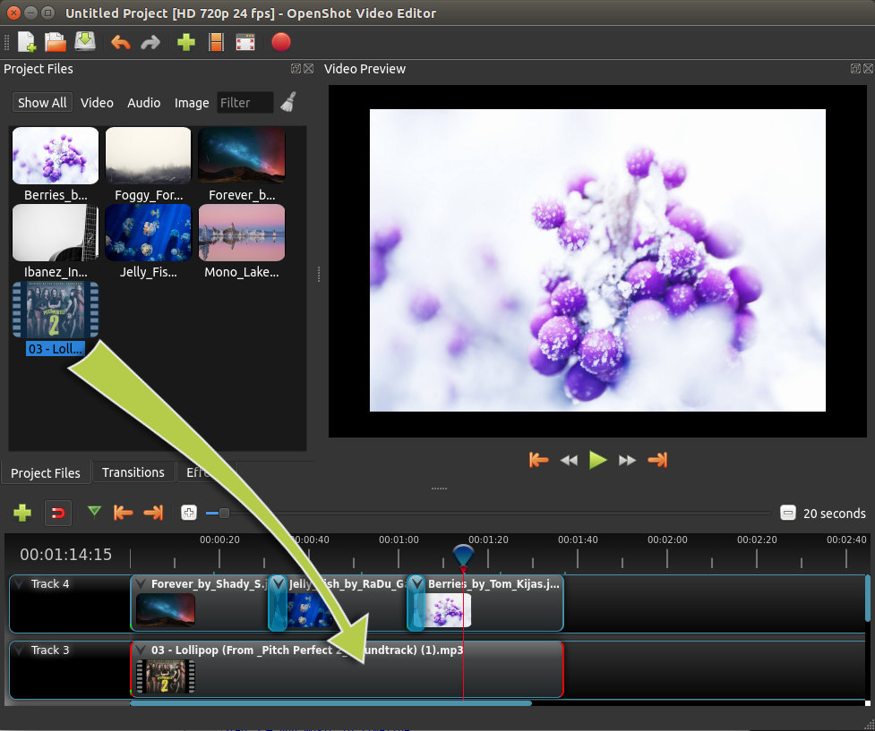
Step 3 – Add Music to Timeline
To make our photo slide-show more interesting, we need to add some music. You should have imported a music file in step 1. Click on the music file, and drag it onto the timeline. If the song is too long, grab the right edge of your music clip, and resize it smaller.

Slide 18
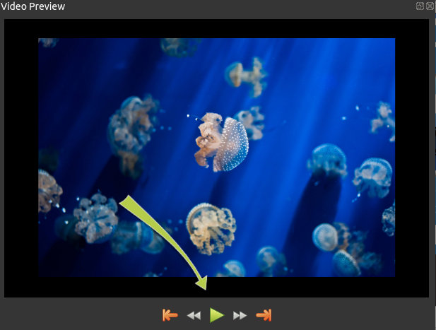
Step 4 – Preview your Project
To preview what our video looks & sounds like, click the Play button under the preview window. You can also pause, rewind, and fast-forward your video project by clicking the corresponding buttons.

Slide 19
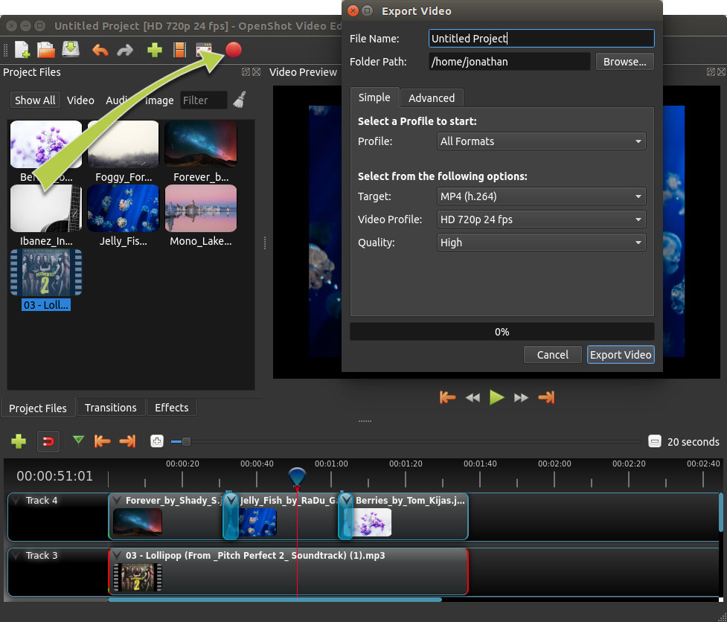
Step 5 – Export your Video
Click on the Export Video icon at the top of the screen (or use the File > Export Video menu). Choose from one of the many preset export options, and click the Export Video button.

Slide 20
Audacity and Openshot - A Summary
Audacity is a free and open-source digital audio editor and recording application software, available for Windows, macOS/OS X and Unix-likeoperating systems.
OpenShot Video Editor is a free and open-source video editor for FreeBSD, Linux, macOS, and Windows. The project was started in August 2008 by Jonathan Thomas, with the objective of providing a stable, free, and friendly to use video editor.

Slide 21
THANK YOU

